Slide 1
Team Debt
Creators Kaleem, Ankur, Fahad & Rabarb

Slide 2
What are the problems?

Slide 3
How are we solving them?
First – The Application and Access to it
Second – Online at Home vs. At Polling Booth:
Third – Security and Safety:
Fourth – Last but not least:

Slide 4
Who can fund us?
Companies and Organisations
Microsoft
CISCO
Tesla
INEC – organize the elections in Nigeria
Crowdfund
Kickstarter
GoFundMe
Crowfunder
Funding
FUNDSFORNGOS

Slide 5
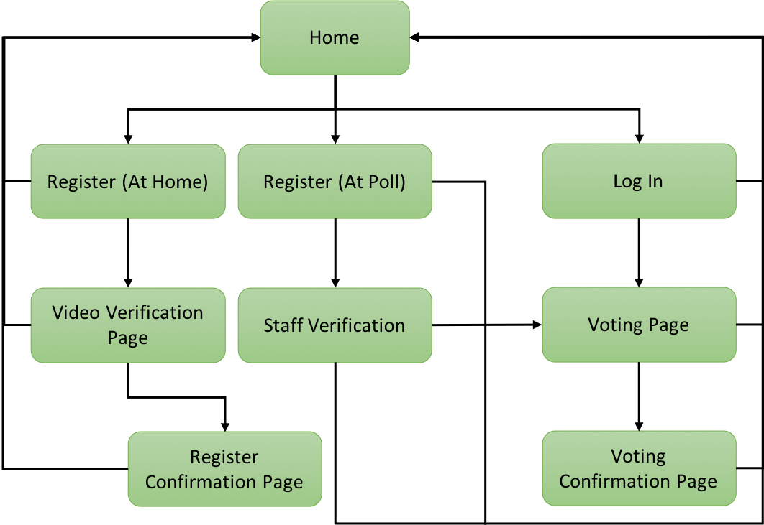
Demonstration of how the web-application would function

Slide 6

References
https://en.wikipedia.org/wiki/Nigerian_general_election,_2015
https://edition.cnn.com/2018/05/31/africa/nigeria-not-too-young-to-run/index.html
www.google.com

